Slide 1
Navigating Student Challenges: Strategies for GTAs
Jessica Gargus, M.Ed., CHES
Assistant Vice Chancellor of Student Life

Slide 2
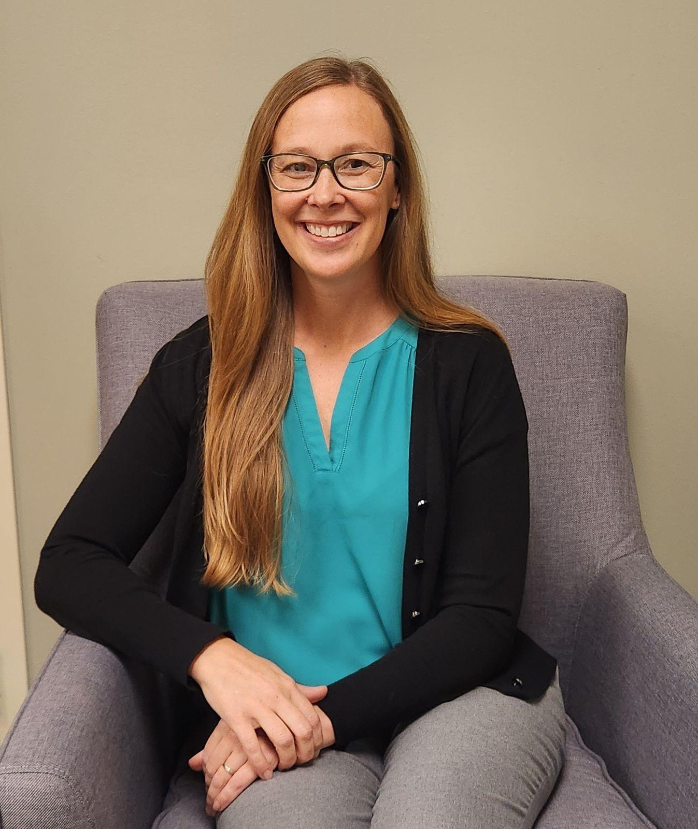
Student Health and Well-Being
The Student Health and Well-Being unit at Missouri S&T takes a collective impact approach to student success, embedding well-being, belonging, and accessibility into campus culture. Through health promotion, prevention, early intervention, and treatment, we ensure students have the support, resources, and access they need to thrive personally, academically, and socially.
Student Health Student Well-Being Student Accessibility and Testing Engagement and Belonging | Student Involvement UCARE/BIT Health and Well-Being Collective Prevention Coalition Joe’s PEERS
Jessica Garus, M.Ed., CHES
AVC Student Life
Notes:
Student Health Services
Urgent Care Clinic/Sports Medicine
Student Well-Being
Counseling/Case Management/Health Promotion/Joe’s PEERS
Student Accessibility and Testing
Disability Services/Academic Testing
Engagement and Belonging
Special Populations/Military & Veterans Center/Food Pantry
UCARE/BIT
JED Health and Well-Being Committee

Slide 3
Outline
  Data and the role of GTAs
  Expanded definition of success and well-being
  Recognizing concerns
  Responding to concerns - dos and don'ts
  Communication/providing language
  Mental Health Crisis Response Guide (Red Folder)
  Self-care

Slide 4
Missouri Assessment of College Health Behaviors
  50% report anxiety in past year
  42% report depression in past year
  45% report stress interfered with their academics
  30% report overwhelming or unbearable stress
  Main sources of stress:
    School/Academics: 90%
    Time Management: 52%
    Financial Concerns: 41%
Future Plans: 46%
Mental Health Concerns: 35%
Loneliness: 20%
Notes:
2023 and 2024

Slide 5
Missouri Assessment of College Health Behaviors
To whom do you go when personal concerns arise?
2024
  Academic advisor - S&T 9%; PIP 21%
  Faculty/professor - S&T 5%; PIP 14%
  Friends/peers - S&T 72%; PIP 76%
2025
  Academic advisor - S&T 9%; PIP 10%
  Faculty/professor - S&T 8%; PIP 12%
  Friends/peers - S&T 82%; PIP 77%

Slide 6
Role of the GTA
As Graduate Teaching Assistants, you bridge the gap between professors and students.
Familiarizing yourself with campus resources and encouraging students to use them creates opportunities for students to thrive in and outside of the classroom.
Serving as a Graduate Teaching Assistant: Tips and Strategies (aspa.net)
Notes:
Most advisors are not clinicians, and we know from working with faculty and advisors that it can feel intimidating or overwhelming to think about supporting students’ emotional health, especially given all the responsibilities you already have. But the good news is that you do not have to be a mental health professional to support a student with their mental health. YOu just need to pay attention, listen, and connect students to help.

Slide 7
Student Success
Traditional Definition
  Grades
  High academic achievement
  Retention
  Graduation rates
  Career outcomes
Expanded Definition
  Well-being
  Connectedness
  Belonging
  Accessibility
  Safety
  Purpose
Notes:
Solve for Tomorrow

Slide 8
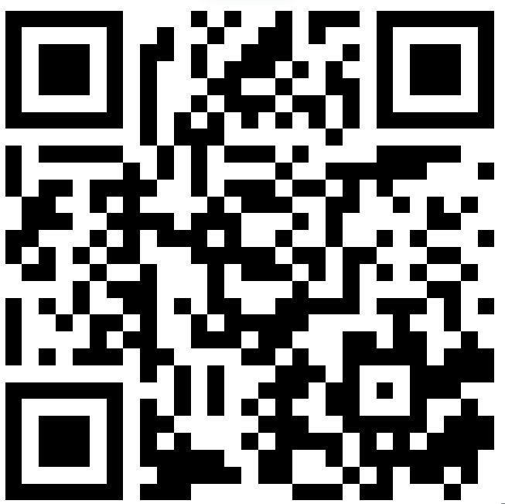
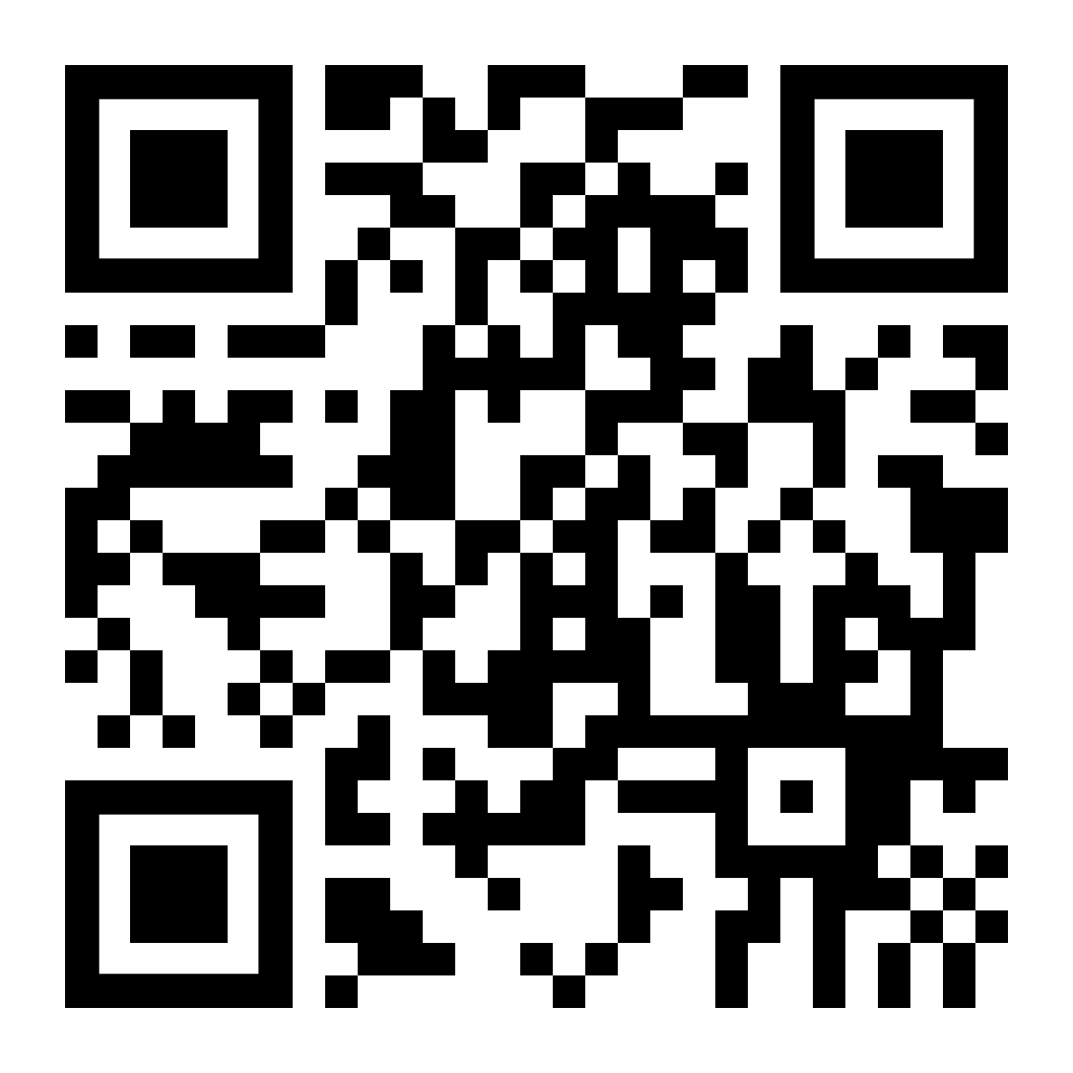
Success in the Classroom
Well-Being and Belonging | Accessibility
https://hwb.mst.edu/classroom-wellbeing/ Classroom strategies: | Student Accessibility and Testing If a student discloses a disability to you or says they think they have a disability: Respect their privacy Do not try to diagnose Refer to Student Accessibility and Testing if seeking accommodative support
Notes:
No prep - breathing activities and short check ins
Short prep - adding resources to syllabus
Long prep - alternative format assignments that play into a students preferred learning style
What is access:
Fully engage and participate in the same activities, campus services, benefits, and experiences offered to a person without a disability
Utilize the same information shared with everyone else
Have the same opportunity to achieve

Slide 9
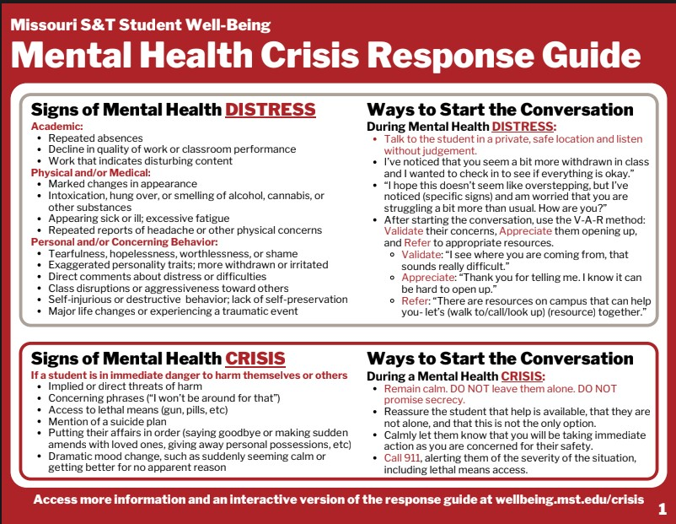
Notes:
The Crisis Decision Tree helps you determine the next best steps when interacting with a student potentially in distress or crisis. It additionally provides wording you can use and all relevant contact information.
On this slide is the picture of the decision tree.

Slide 10
Recognizing Signs of Distress
Important signs to pay attention to, because they may indicate a student is struggling and needs support:
  Missed assignments
  Repeated absences
  Decline in academic performance
  Reduced participation in class/club
  Excessive fatigue
  Poor personal hygiene
  Inappropriate or exaggerated behavior
  Alarming or worrisome content in speech or assignments
Notes:
Jessica

Slide 11
Notes:
The Crisis Decision Tree helps you determine the next best steps when interacting with a student potentially in distress or crisis. It additionally provides wording you can use and all relevant contact information.
On this slide is the picture of the decision tree.

Slide 12
Tips for Directly Intervening
Do:
Don’t:
Argue, raise your voice, or take things personally
Focus on the person—address the behavior
Press for “why” or restrict movement
Dismiss or minimize their concerns
Use a calm, gentle tone; be firm and specific
Listen and allow the student to share
Acknowledge strengths and validate emotions
Show empathy and suspend judgment
Focus on what you hear, not your reaction

Slide 13
VAR Method
When A Student Approaches You with a Concern
  Validate: Validate their concerns and feelings
    “I’m sorry you’re going through that, you have every right to feel the way you do”
  Appreciate: Appreciate them opening up to you; this can be difficult!
    “Thanks for letting me know how you’ve been feeling, I can’t imagine how hard it’s been feeling like this on your own”
  Refer: Provide support, resources, and hope
    “I know that group counseling is helpful, can I tell you more about it? How else can I support you now?”

Slide 14
How to Start the Conversation
Ways to approach a struggling student
Be observant and gentle. Begin with observations, not accusations
    “I’ve noticed you've been quieter than usual in class. Would you be open to sharing what’s on your mind?
Provide specific instances to show genuine concern
    “I saw you seemed quite upset after our last group meeting. How have things been going for you since then?”
Notes:
“I’ve noticed you’ve seemed a little down lately, so I wanted to check in with you. What’s been going on?”
“I noticed you missed classes a few times. What’s going on for you?”
“You seem really tired in our meetings lately. How are you doing these days?”
“I’ve noticed you've been quieter than usual in our sessions, is everything okay?”
“I saw you seemed quite upset after our last group meeting. How have things been going for you since then?”

Slide 15
How to Start the Conversation
Ways to respond when a student shares their struggle with you
  Acknowledge and validate their feelings
    “It sounds like you’re facing a lot of pressure. It’s completely okay to feel this way, and I’m here to support you.”
  Offer immediate support while respecting their autonomy
    “Would you like to explore some resources together, or would you prefer to talk about what’s been bothering you more?”
Notes:
“I’m so glad you told me about this. Let’s brainstorm how we can get you some support.”
“Thank you for sharing this with me. There’s good support on campus—I’ll help connect you to it.”
“Wow, that sounds really hard. It makes sense you are struggling. Let’s figure out what on-campus supports can help you right now.”
Remember to approach students with empathetic and effective communication skills.

Slide 17
Recognizing Signs of Crisis
When immediate intervention is needed
Implied or direct threats of harm to self or others
Access to lethal means
Mention of a suicide plan
Written or spoken references to suicide or violence
Repeated statements of hopelessness
Sudden emotional outbursts
Aggressive or violent behavior
Notes:
Jessica

Slide 19
How to Start the Conversation
Ways to talk with a student who needs immediate help
  Communicate urgency without causing alarm
    “You’re not alone in this. It’s important we speak with someone who can provide the right support immediately. I can accompany you.”
  If the student is resistant but in crisis, ensure their safety is the priority
    “Your safety is very important. I need to involve others to ensure you’re supported effectively.”
Notes:
“I understand that you are hurting right now. I am here to help you and connect you to good support on campus.”
“I hear that you feel hopeless right now. I’ve worked with the counseling center, and I think they could help. Let’s walk over together.”
“I can tell that you’re very upset, and I’m concerned about you. I’m going to connect you with someone who can help you stay safe.”
If a student declines support, call campus security or 911.

Slide 20
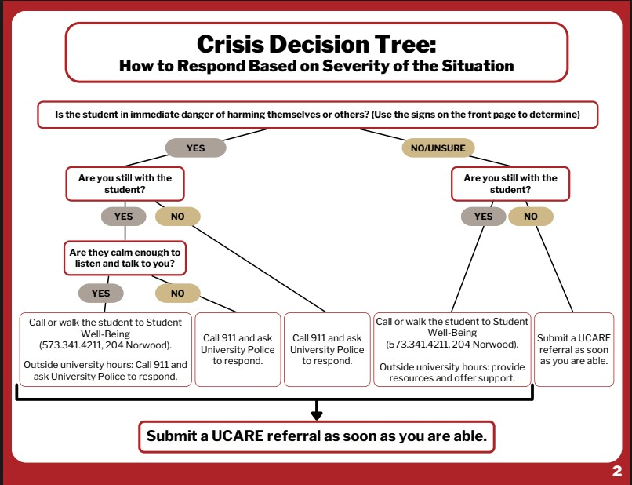
Notes:
Now if you are still unsure and the question remains to if the situation is a crisis, or if the student is in distress you can proceed to the decision tree on the other side.
Here we can see a basic outline of determining what action to take based on some basic questions.
(Click)
We start with the question if the student is in immediate danger of harming themselves. From there based on the answers to these questions we can determine which resource to access.
(Click) Listed on the bottom are the various options based on the student’s need. Notice, the final action in all cases is to submit a UCARE report.

Slide 21
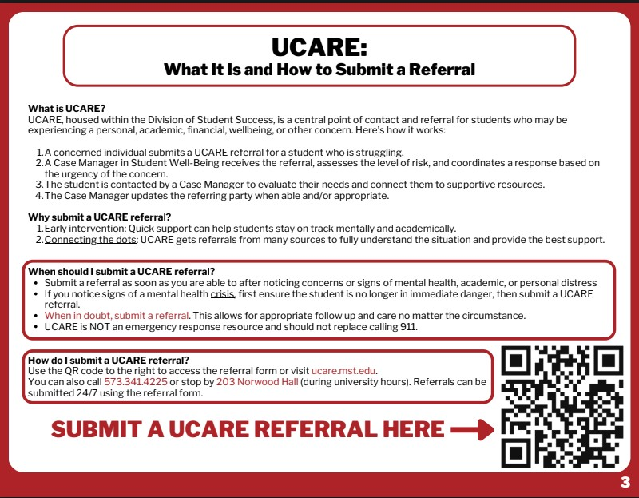
Notes:
Just in case you are not familiar with UCARE, the section opposite of the decision tree is some information about UCARE, with information about filing a report and (Click) even a QR code that makes it easy to find the form online.

Slide 22
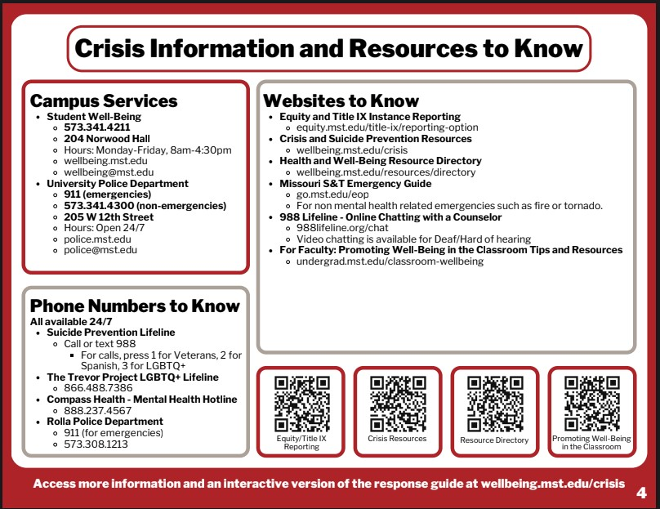
Notes:
Finally on the back of the Folder you will find a list of phone numbers and contact information for a variety of services both on campus (click) and Off (Click). Finally there are also QR codes on the back to locate additional information about crisis intervention and resources.

Slide 23

Self-Care
Self-care is the practice of taking action to help sustain or improve your own well-being.
Significance for GTAs:
The quality of guidance you provide can be interconnected with your well-being.
What does self-care mean to you?
Notes:
Remember you cannot pour from an empty cup so taking care of yourself is important in order to be able to help others.

Slide 24
Examples of Self-Care
  Spending time alone to decompress
  Organizing/tidying/ cleaning
  Getting outside
  Taking care of your body
  Laughing
  Practicing self-compassion
  Positive self-talk
  Practicing healthy coping strategies and stress relief
  Saying no when needed
  Acknowledging your feelings
  Asking for help
  Spending time with people you care about
  Connecting with your peers

Slide 25
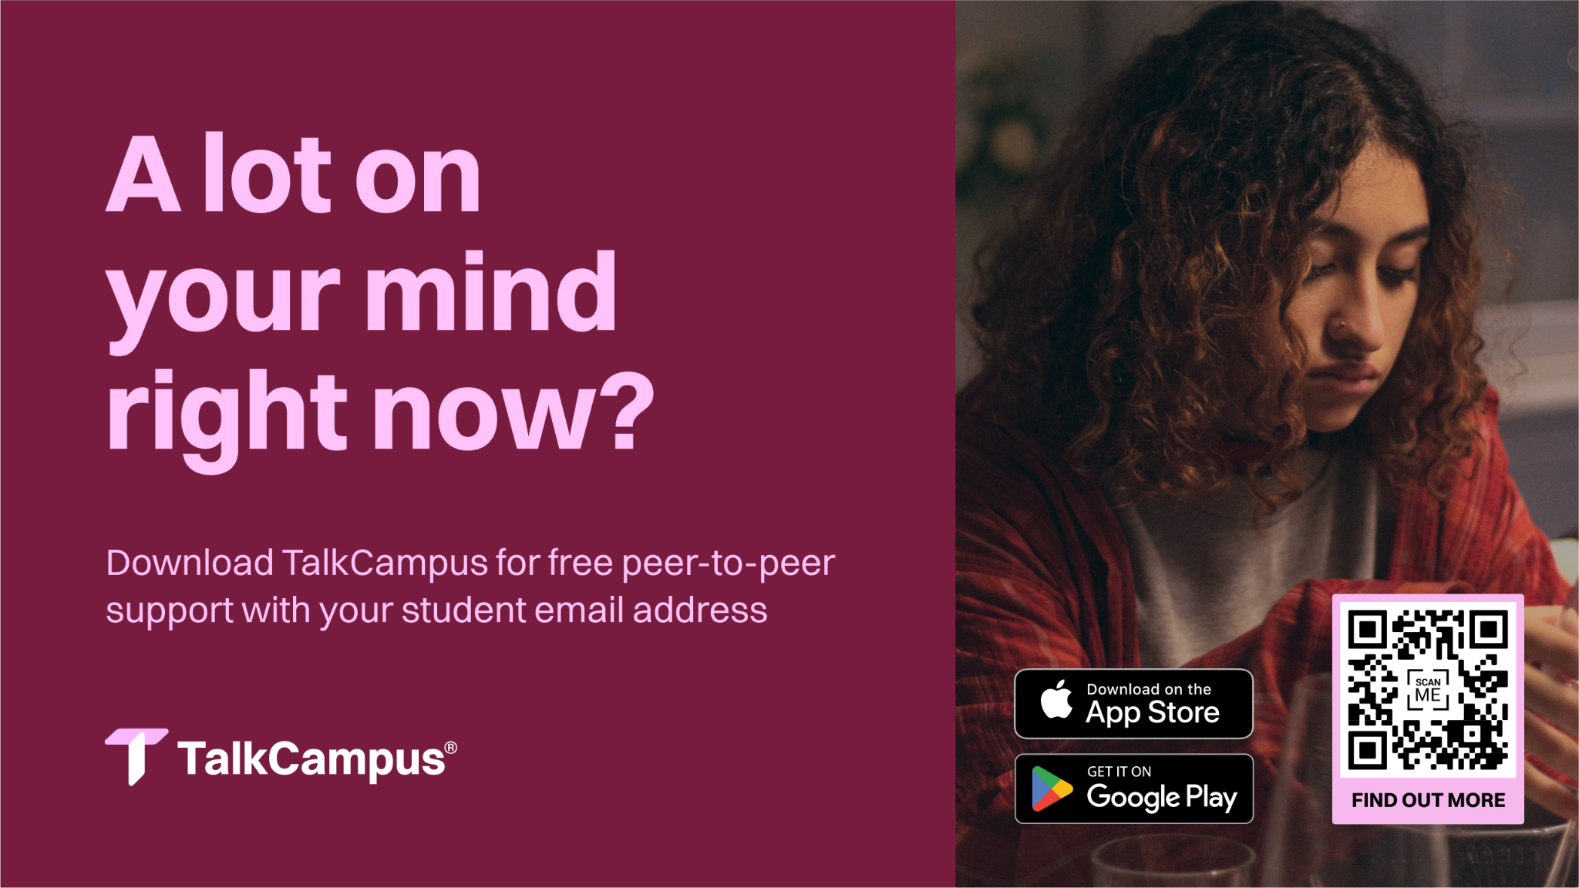

Slide 26

Thank You!
Jessica Gargus gargusj@mst.edu

